Slide 1
How do we make the triangle colder?

Slide 2
Team Members
Rebecca Rozansky Junior
Blue is the colour of the clear sky and the deep sea
Shara He Senior
Blue is the colour of the clear sky and the deep sea
Daqi (Jen) Chen Junior
Blue is the colour of the clear sky and the deep sea

Slide 3
1.
Methods
We conducted EDA, ML Algorithms

Slide 4
What correlated with a high heat index?
Chapel Hill had a strong negative correlation with per capita Income: -.58
Raleigh-Durham had a strong negative correlation with tree coverage: -.68

Slide 5
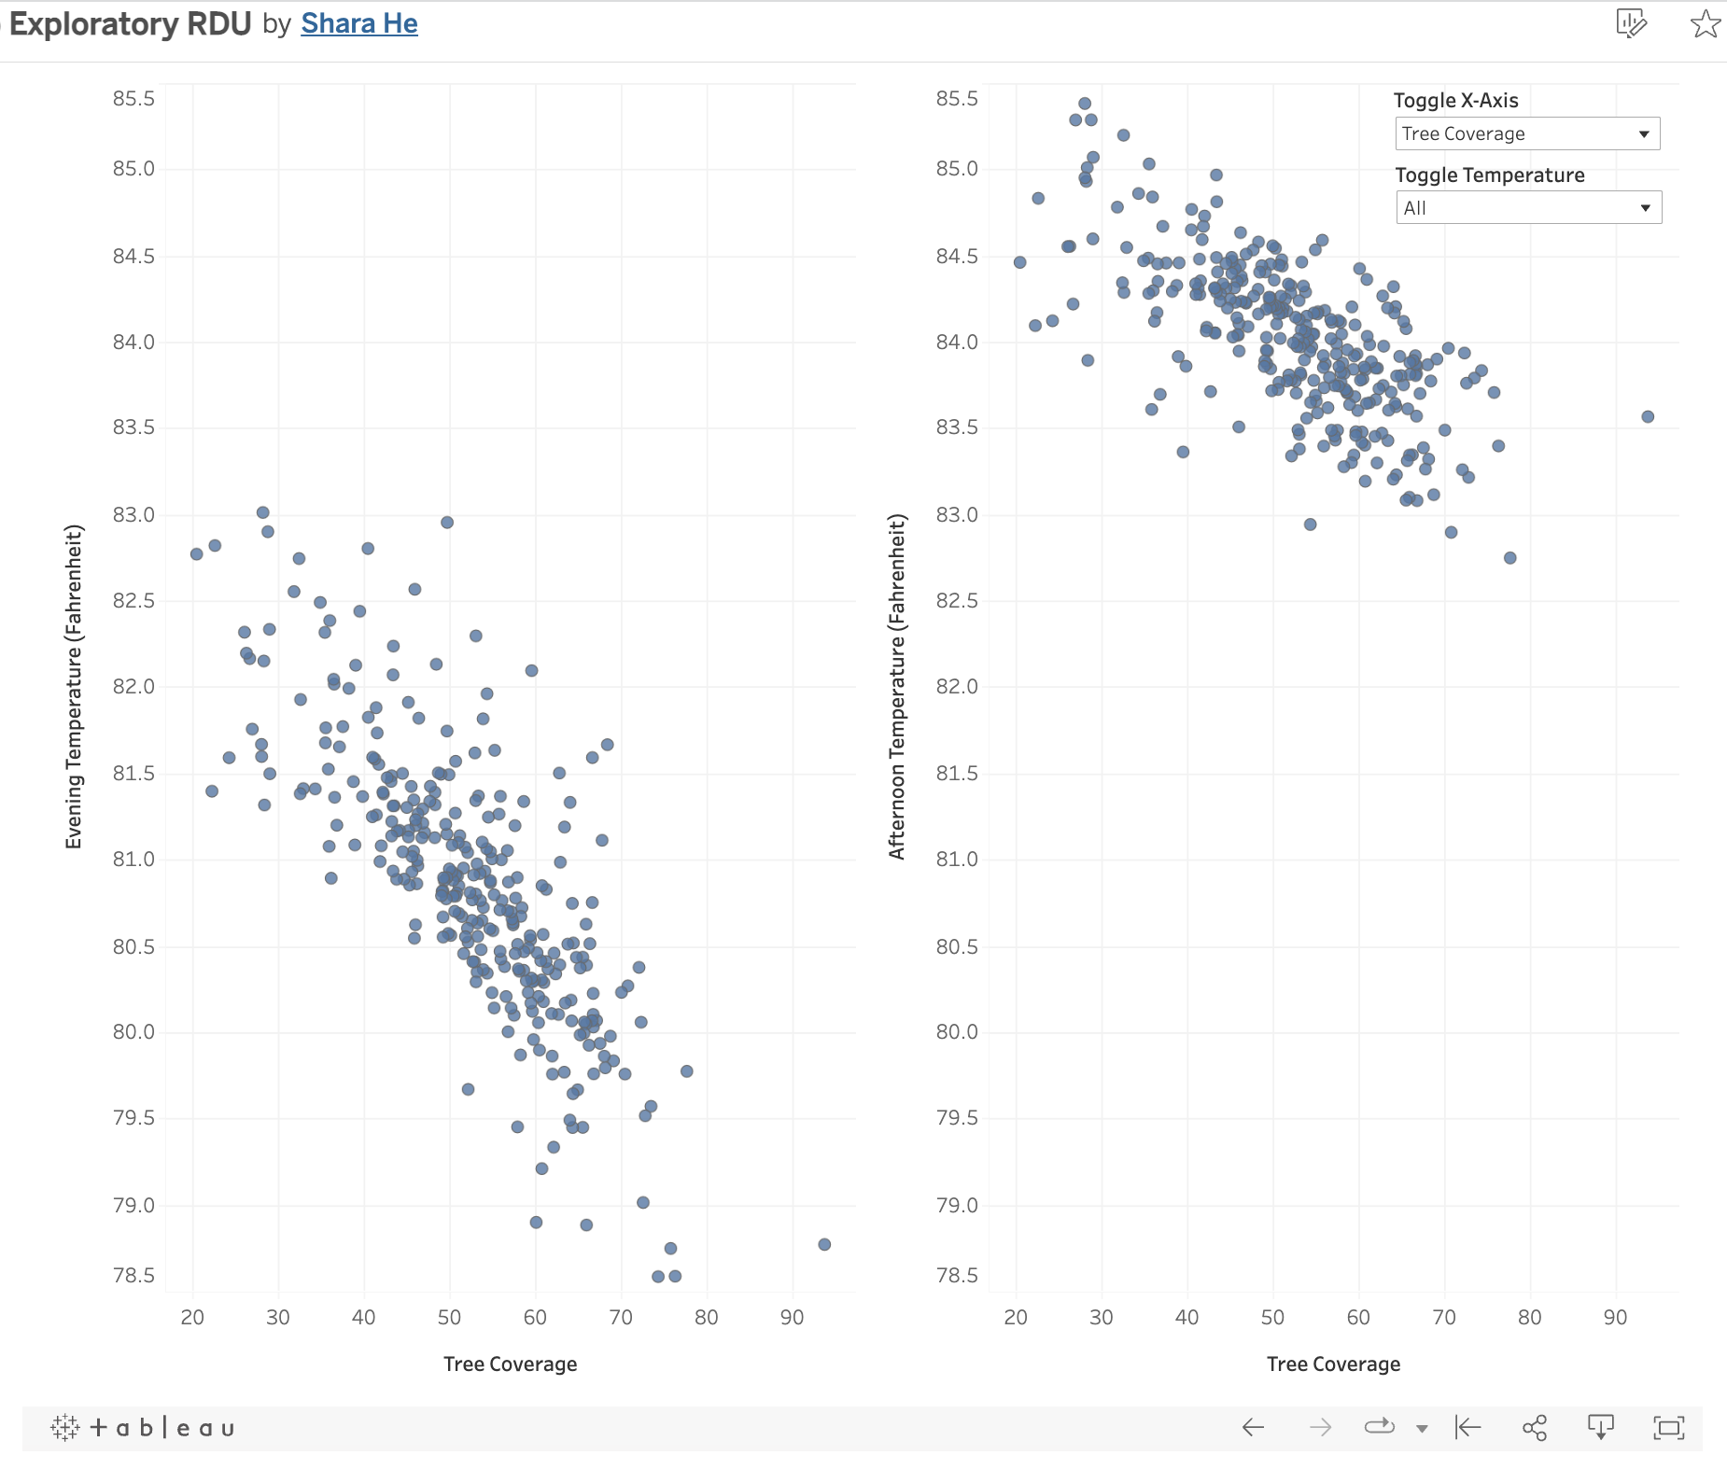
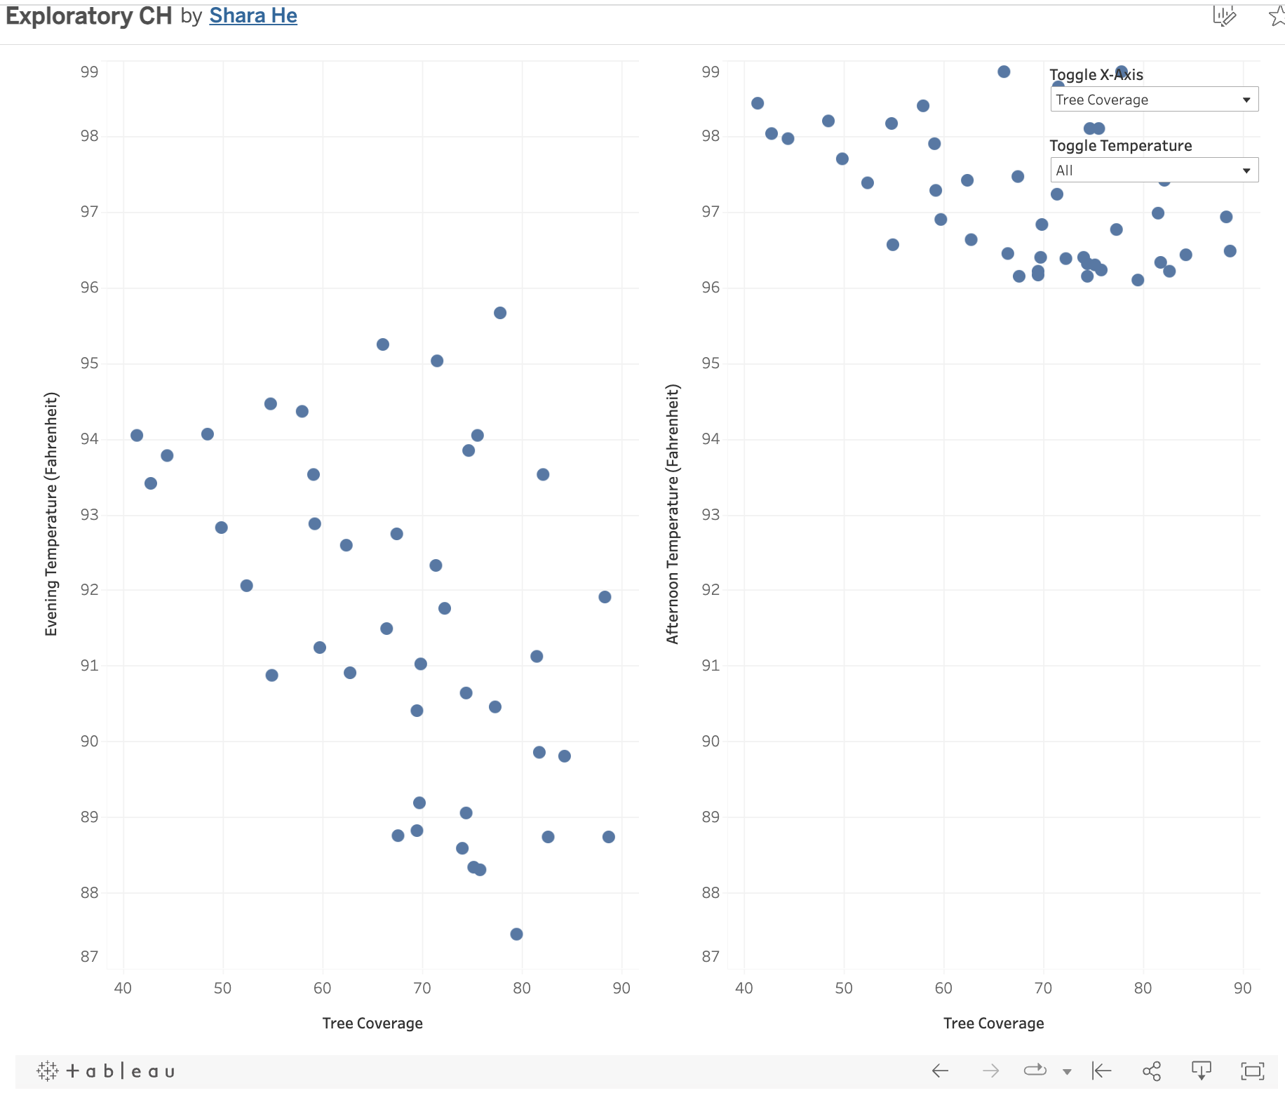
Tree Coverage and Temperature Trends
Raleigh-Durham
Chapel Hill

Slide 6
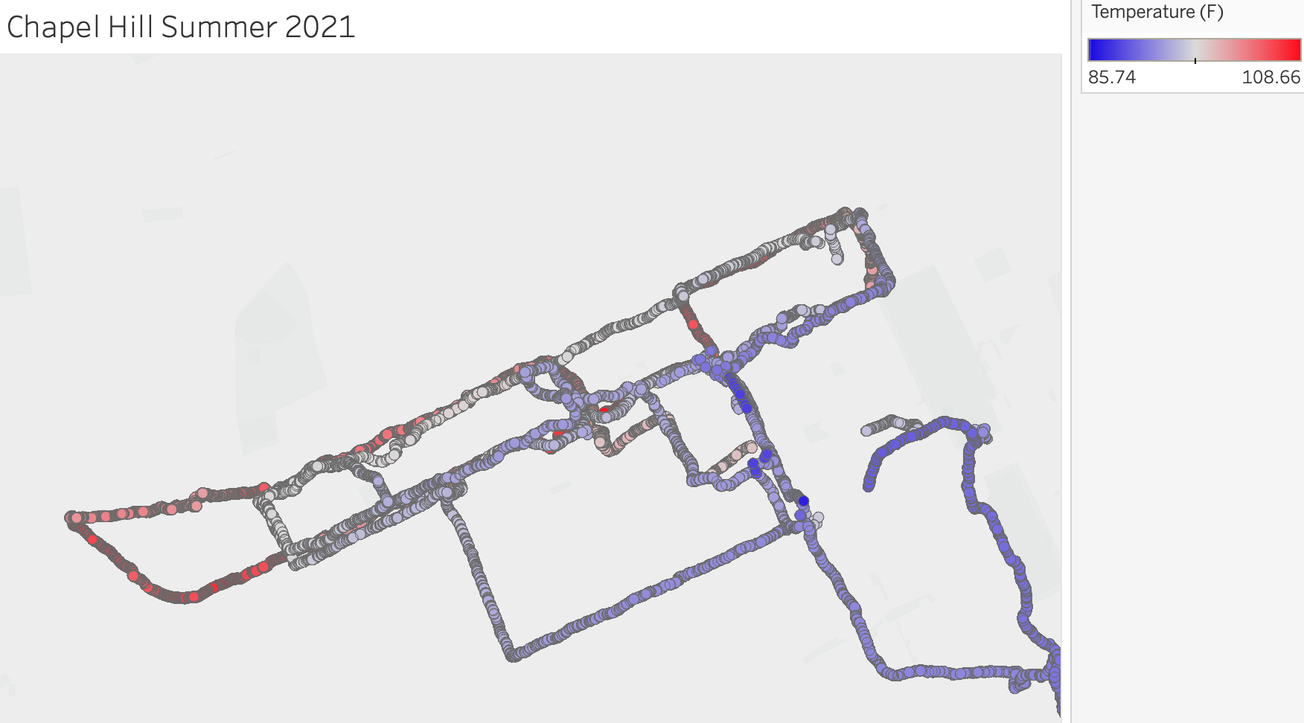
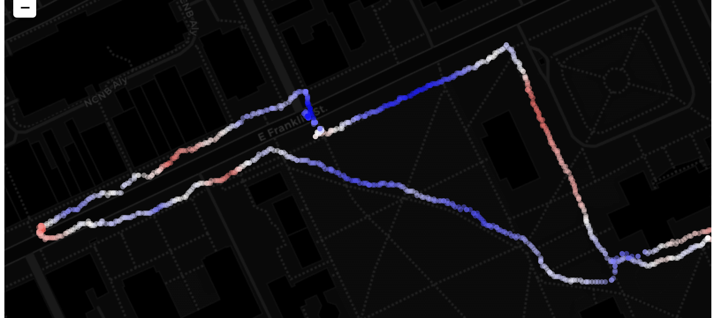
PocketLab Sensors Comparison by Franklin Street
Today, 10:45am

Slide 7
Machine Learning
Bring the attention of your audience over a key concept using icons or illustrations

Slide 8
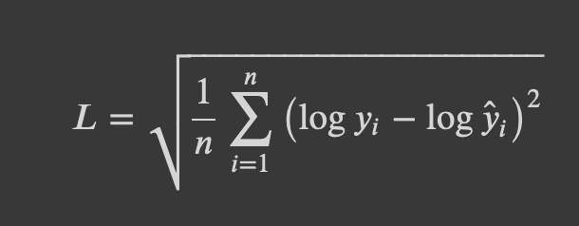
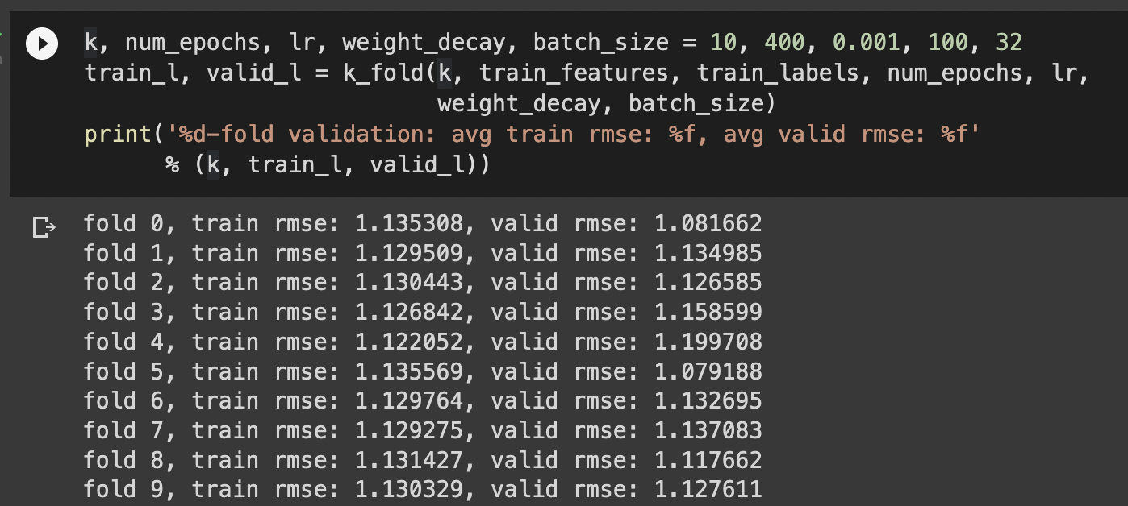
https://colab.research.google.com/drive/1i7USFpdfVRrAToHFVSLmBr7zTvi2z-9h?usp=sharing

Slide 9
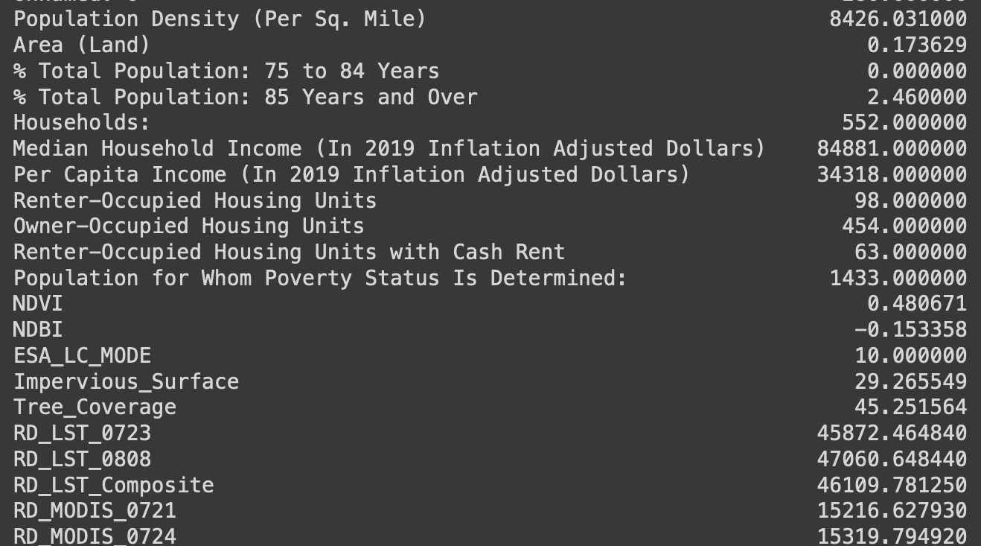
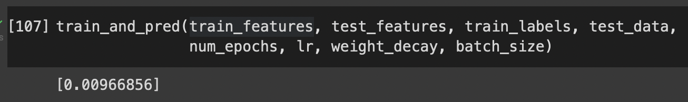
Multi-Layer Neural Network
OUTPUT
0.0097
ISSUE
High Training Error
Making Target variable binary and do binary classification.
More data points.

Slide 10

Publicize via Marketing Flyers
Inform citizens about urban heat health risks
Share resources to learn more about local urban heat zones
Encourage citizens to hydrate!
https://rebeccarozansky.github.io/heat-app/

Slide 11
Thanks!
Any questions?

